Slide 1
PipelineC Encryption Engine for Wireguard
All sketches/diagrams: https://drive.google.com/file/d/1GexFq3fNEDgnXyx9oWG8lRr8Ke6I_arX/view?usp=sharing
Current code:
https://github.com/JulianKemmerer/PipelineC/tree/master/examples/chacha20poly1305
Soon moving code into ChiliChips repo...
Slides https://docs.google.com/presentation/d/1khJMUxEejUFGjp03GPbxSCazEnpTkH4NK66NHhkcd2Y/edit?usp=sharing

Slide 2
Porting:
Pure functions for crypto math mostly same as software
Converted to pass by value, fixed size arrays
Auto-pipelined by tool, HLS like
Could be made to compile with gcc
Design architecture: pipelines and FSMs
Architecture manually developed (not product of HLS like things)
Regular RTL, state machines, processes etc hardware people would recognize
All valid-ready AXIS style handshaking used

Slide 3
Status:
Encrypt side correctly produces ciphertext and auth tag output
Only one hard coded packet tested (based on software demo main.c)
Only tested VHDL output, via GHDL(via cocotb)

Slide 4
Example pure func ‘math’ porting
Software C PipelineC
// a += n
uint320_add(&a, &a, &n);
// a *= r
uint320_t temp = a;
uint320_mul(&a, &temp, &r);
// a %= p
uint320_mod_prime(&a);
// a += n
a = uint320_add(a, n);
// a *= r
a = uint320_mul(a, r);
// a %= p
a = uint320_mod_prime(a);

Slide 5
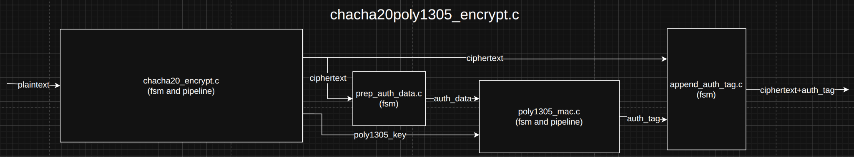
Block Diagram

Slide 6
Top Level HDL ports
clk_80p0 : in std_logic;
key : in unsigned(255 downto 0);
nonce : in unsigned(95 downto 0);
aad : in unsigned(255 downto 0);
aad_len : in unsigned(7 downto 0);
s_axis_tdata : in unsigned(127 downto 0);
s_axis_tkeep : in unsigned(15 downto 0);
s_axis_tlast : in unsigned(0 downto 0);
s_axis_tvalid : in unsigned(0 downto 0);
s_axis_tready : out unsigned(0 downto 0);
m_axis_tdata : out unsigned(127 downto 0);
m_axis_tkeep : out unsigned(15 downto 0);
m_axis_tlast : out unsigned(0 downto 0);
m_axis_tvalid : out unsigned(0 downto 0);
m_axis_tready : in unsigned(0 downto 0)
Notice no reset...

Slide 7
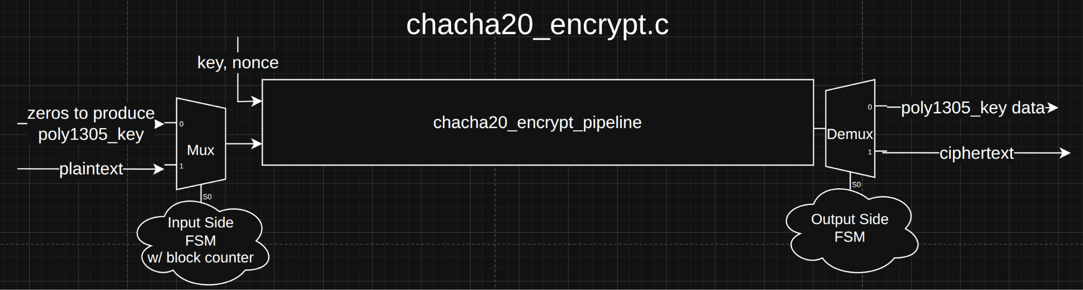
Chacha Block

Slide 8
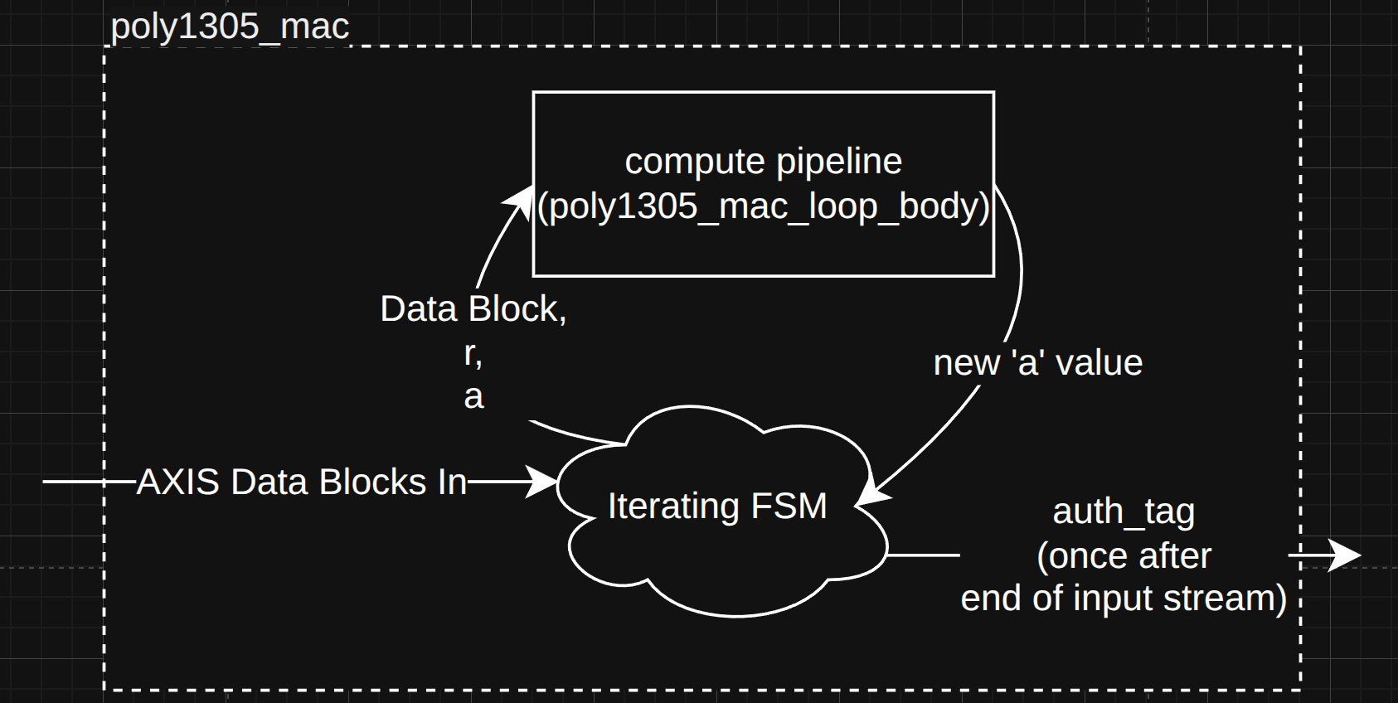
Poly Block

Slide 9
Timing:
Does meet 80Mhz target without issue
chacha20_encrypt_pipeline : 61 clocks latency
poly1305_pipeline : 6 clocks
Room for improvement since code not optimized for hardware yet
Ex. bit manipulation

Slide 10
Throughput
ChaCha20 encrypt
Can fully utilize pipeline, II=1
64 byte (512bit) block size * 80MHz = ~40 Gbit per sec
Underutilized at our max ~10 Gbit per sec
Could redesign to save some resources
Poly1305
Cannot fully utilize pipeline as designed
Iterating, one block in flight at a time
~6-8 cycles per block, 16 byte block, 80MHz
~1-2 Gbit per second currently - is bottleneck
Have plan for full throughput design, requires more resources, mostly BRAM

Slide 11
Resources:
Report Cell Usage:
+------+-----------+------+
| |Cell |Count |
+------+-----------+------+
|1 |CARRY4 | 3884|
|2 |DSP48E1_10 | 22|
|3 |DSP48E1_11 | 12|
|4 |DSP48E1_12 | 3|
|5 |DSP48E1_13 | 6|
|6 |DSP48E1_14 | 9|
|7 |DSP48E1_15 | 6|
|8 |DSP48E1_16 | 3|
|9 |DSP48E1_17 | 4|
|10 |DSP48E1_18 | 2|
|11 |DSP48E1_19 | 1|
|12 |DSP48E1_20 | 2|
|13 |DSP48E1_21 | 2|
|14 |DSP48E1_22 | 1|
|15 |DSP48E1_3 | 2|
|16 |DSP48E1_4 | 9|
|17 |DSP48E1_5 | 12|
|18 |DSP48E1_7 | 6|
|19 |DSP48E1_8 | 9|
|20 |DSP48E1_9 | 39|
|21 |LUT1 | 1027|
|22 |LUT2 | 8118|
|23 |LUT3 | 10262|
|24 |LUT4 | 3961|
|25 |LUT5 | 1889|
|26 |LUT6 | 1584|
|27 |RAMB18E1 | 1|
|28 |RAMB36E1 | 8|
|29 |SRL16E | 5620|
|30 |SRLC32E | 1924|
|31 |FDRE | 25254|
+------+-----------+------+
Room for improvement since code not optimized for hardware yet
Ex. bit manipulation, turn off some extra regs on CSR signals
~25% of FPGA used...
+----------------------------+-------+-------+-----------+-------+
| Site Type | Used | Fixed | Available | Util% |
+----------------------------+-------+-------+-----------+-------+
| Slice LUTs* | 32542 | 0 | 134600 | 24.18 |
| Slice Registers | 25254 | 0 | 269200 | 9.38 |
+-------------------+------+-------+-----------+-------+
| Site Type | Used | Fixed | Available | Util% |
+-------------------+------+-------+-----------+-------+
| Block RAM Tile | 8.5 | 0 | 365 | 2.33 |
+----------------+------+-------+-----------+-------+
| Site Type | Used | Fixed | Available | Util% |
+----------------+------+-------+-----------+-------+
| DSPs | 150 | 0 | 740 | 20.27 |

Slide 12
Testing:
Currently hard coded single packet testbench in PipelineC (via VHDL va GHDL+cocotb)
Plan was for Verilator/C++ based test bench yes?
Want to test:
Multiple packets
Reset?
How/when CSR signals change / remain stable

